Slide 1
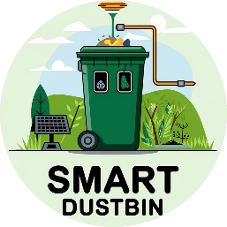
SMART COMPOSTING DUSTBIN

Slide 2
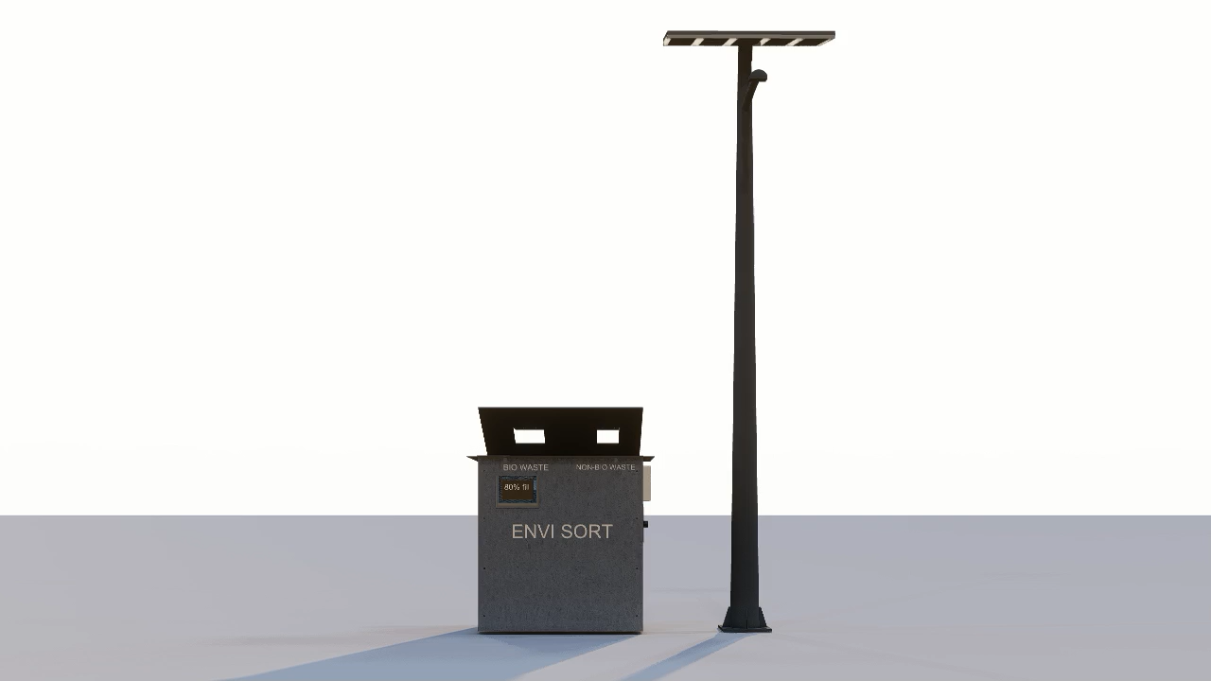
ABSTRACT:
3D MODEL
The Smart Dustbin is an automated system for efficient waste management that converts biodegradable waste into manure using an electrode-based combustion chamber made of stainless steel. When the biodegradable bin reaches 80% of waste, the waste is automatically transferred to the combustion chamber, where it is processed into mineral-rich ashes.
The system is equipped with sensors for fill-level tracking, geolocation, and temperature monitoring. If the temperature exceeds a predefined limit, the system pauses to allow cooling before resuming operation, ensuring both safety and efficiency.
Activated charcoal filters neutralize harmful gases and odors. The final product is mineral-rich ash, which can be processed into high-quality fertilizer. This approach promotes sustainability, reduces landfill use, and encourages proper waste segregation.

Slide 3
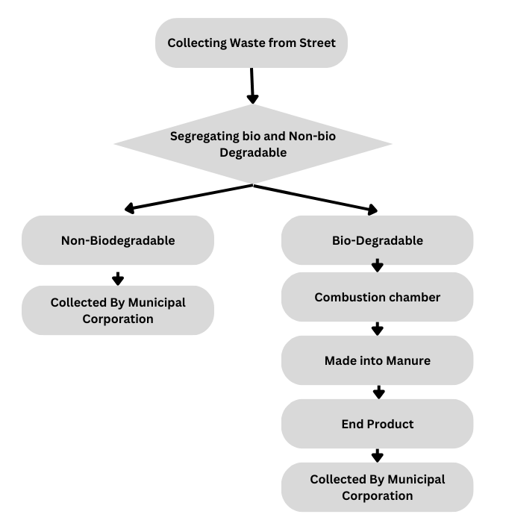
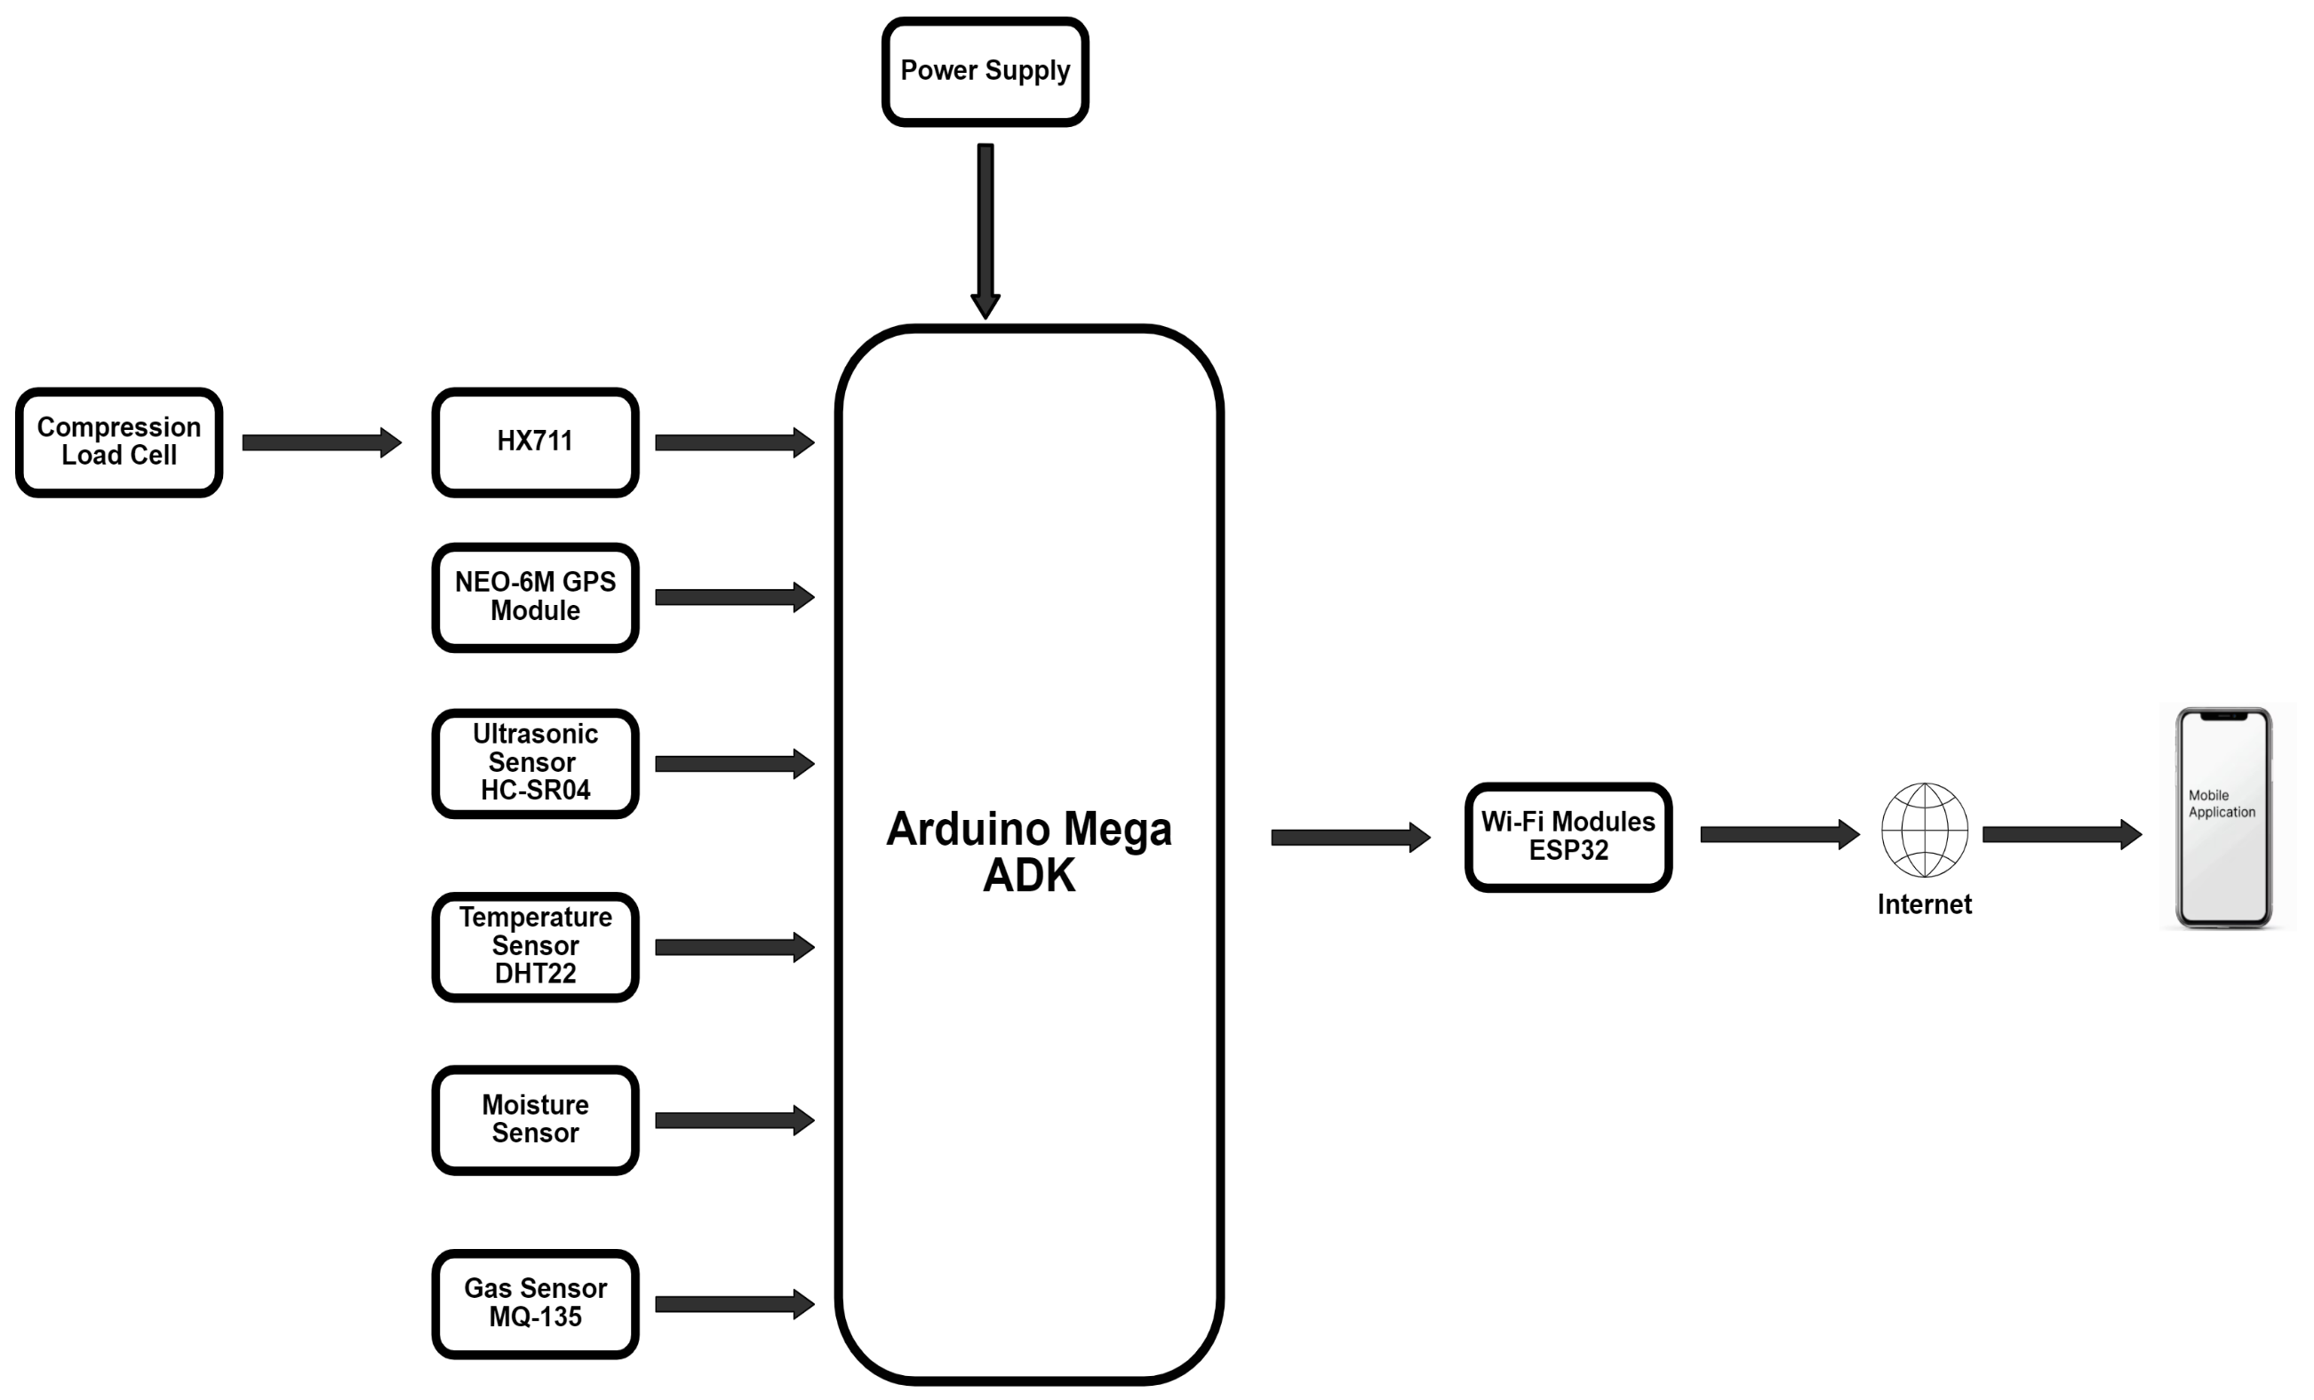
FLOW DIAGRAM
BLOCK DIAGRAM

Slide 4
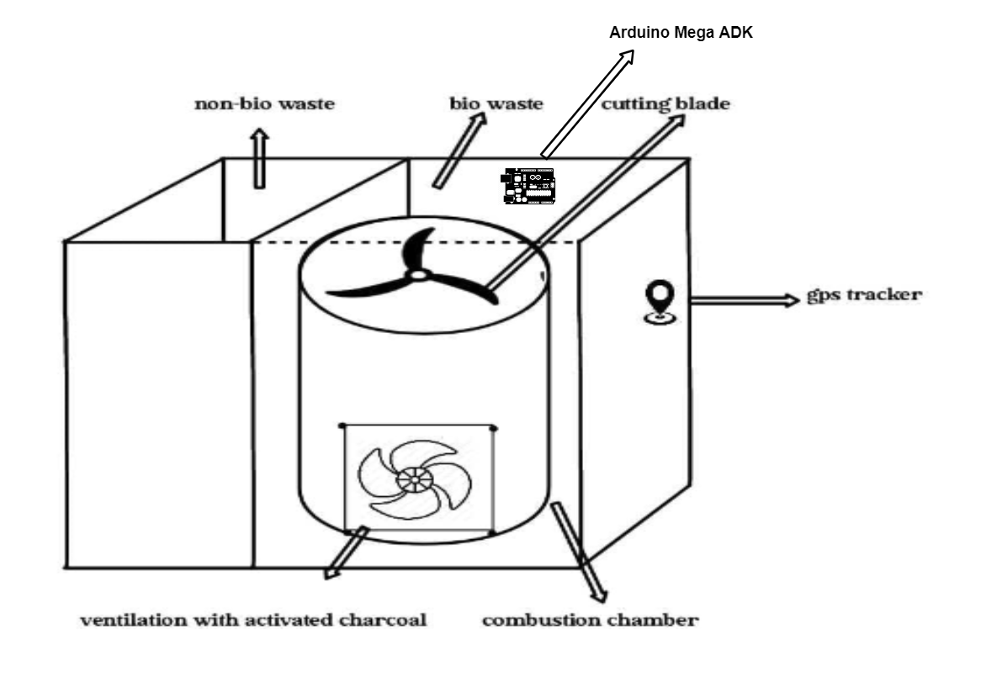
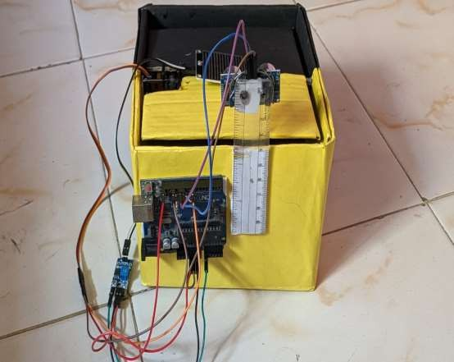
CONSTRUCTION:
INITIAL PROTOTYPE:

Slide 5
How the Smart Dustbin Works:
1.Waste Disposal: Citizens dispose of biodegradable and non-biodegradable waste into separate chambers.
2.Fill-Level Detection: The ultrasonic sensor tracks the fill level of the biodegradable waste chamber. Once it reaches 80%, the waste is transferred to the combustion chamber.
3.Combustion Process: The system uses electrical energy to heat the waste. The integrated blades shred the waste for faster combustion. The combustion chamber temperature is closely monitored to ensure it does not exceed safe limits.
Emission Control: During combustion, harmful gases are passed through activated charcoal filters, ensuring that only clean air is released without of odor.
1.Ash Collection: The mineral-rich ash produced as a byproduct is collected and can be processed into fertilizer.
2.Remote Monitoring: The system sends real-time data on the status of the bin (e.g., fill level, temperature) to municipal authorities through a web application integrated with an IoT platform.

Slide 6
NOVALTY
Odor Control:
During the decomposition and combustion of biodegradable waste, unpleasant odors are released. Activated charcoal adsorbs these odor-causing compounds, trapping them in its porous surface. This ensures that the surrounding environment remains odor-free.
Neutralization of Harmful Gases:
The combustion process can release gases like methane or volatile organic compounds (VOCs), which are harmful to both the environment and human health. Activated charcoal traps these gases before they can escape into the atmosphere, making the waste conversion process more environmentally safe.
Sustainability:
Since activated charcoal can be regenerated and reused after saturation (by heating it to release the adsorbed substances), it aligns with the Smart Dustbin’s focus on sustainability. This reusable nature reduces waste and ensures the system remains efficient in the long run.

Slide 7
Conversion of Biodegradable Waste to Mineral-Rich Ash
In a street with 120 houses
Daily Waste Collection: 180 kg/day
Total Waste Collected in a Week: 1,260kg/week
Of this, 60% (756 kg) is biodegradable waste,
Financial Insights:
Selling Price of Ash: ₹80 per kg.
Potential Revenue from Ash Per Bin:
Weekly: 75.6 kg×₹80 = ₹6,048.
Yearly: ₹6,048×52 weak = ₹3,14,496.
Investment in Waste Management:
Cost per Bin: ₹2,00,000.
Implementation of 100 Bins: Investment of ₹2 crore.
Weekly Profit per Bin: ₹6,048.
Yearly Profit per Bin: ₹3,14,496.
Total Profit for 100 Bins: ₹3,14,49,600.
Maintenance and Additional Costs:
Total Maintenance cost per Bin: ₹36,000.
Net Yearly Profit:
Total Profit: ₹3,14,49,600.
Maintenance Costs: ₹36,00,000.
Net Yearly Profit: ₹2,78,49,600.

Slide 8
Financial Projections for the Next 3 Years:
Financial projection for the Smart Dustbin project for the next 3 years. The projections are based on assumptions around the adoption rate of the technology, revenue from the sale of mineral-rich fertilizer, and expected growth in the number of bins deployed.
Year | Total Valuation of Startup | Total Customers (Bins Deployed) | Total Revenue from Fertilizer | Total Maintenance Cost | EBITDA (Profit Before Investment Deduction) | Profit After Investment/Maintenance
Year 1 | ₹10,00,000 | 100 | ₹3,14,49,600 | ₹36,00,000 | ₹2,78,49,600 | ₹78,49,600
Year 2 | ₹12,00,000 | 120 | ₹3,77,39,520 | ₹43,20,000 | ₹3,34,19,520 | ₹2,90,99,520
Year 3 | ₹15,00,000 | 144 | ₹4,52,47,104 | ₹51,84,000 | ₹4,00,63,104 | ₹3,48,79,104

Slide 9
BENEFITS:
Financial Viability:
Initial Investment: Lower profits in the first year due to innovative bin technology investment, leading to long-term cost savings and increased profitability.
Long-Term Savings: Reduced landfill disposal costs and extended landfill lifespan.
Revenue Generation: Selling high-quality manure from biodegradable waste.
Social Benefits:
Cleaner Streets: Automated waste collection and segregation.
Public Awareness: Educates communities on waste segregation and recycling.
Operational Efficiency:
Real-Time Monitoring: Enhances waste collection efficiency.
Scalable Solution: Suitable for various urban areas.
Environmental Impact:
Reduces Landfill Waste: Converts biodegradable waste into manure.
Promotes Sustainable Practices: Encourages composting and reduces carbon footprint.

Slide 10
THANK YOU

